Slide 1
HOW TO MARKET YOUR BRAND IN UNKNOWN TERRITORY
Plan, Initiate then Execute
Presented by Nadine Bryan
Director

Slide 2
CONGRATULATIONS!!!
Welcome to the birthplace of your new IDEA
Sleep deprivation, Stress and Anxiety. Though overshadowed by a feeling of motivation, commitment and achievement.
You are now in the minority the sector of the population to be your own boss and to be a boss. To not only be a PROVIDER of yourself but to others, to leave a Blueprint, Legacy and to make a DIFFERENCE.
SKILLS SET
Your Why
Self Belief
Motivation
Commitment
AIDS
Pen & Notebook

Slide 3
PLANNING Now that you have established; - What your Business is? (Service/ product, target market) - Why you’re in Business? (This should not be motivated by money) - How you’re going to Fund your business
BUSINESS PLAN
This now needs to be put into a Business Plan (BP), it is ‘Rule 101’ of having a successful business and every successful company has one.
Your Notebook underpins your ideas and becomes a very important aid to everything you do business related.
That being said the BP is the ‘Foundation’, all of the Notebook ideas gets formalised into this Plan and will evolve into the ‘Building Block’ that will house all of the companies fabric, values, principles and future innovations.

Slide 4
Why is it so important?
The rationale behind this is that is has an overview of core information about;
The proposal/ Idea
Values and Principles
Funding
Market Research
Financial Projection
Marketing Strategies
Years 1-5 Future plans
These are the basics elements to consider but you can elaborate to fit within your chosen industry.
Your BP will also have an influence on your ‘Brand Book’ should you choose to have one. So the possibility of the BP has endless elements that will run throughout your business.
The BP is a document that will be revised and updated many times, this is normal and is a positive sign that your idea is developing.
Nevertheless, it is very valuable to your business especially if you need a loan from the bank, an investor or potential business partner(s) who will want to view it, so it’s important that you get it right.

Slide 5
DEVELOP YOUR BUSINESS IDEA
RESEARCH
Do you really know your business?
What’s your USP?
Product Innovation
Be well researched about your customer
What’s your marketing plan?
What’s your position in the market – Who do you want to be?
Pricing strategy?

Slide 6
DEVELOP YOUR BUSINESS IDEA - Continued
FINANCIAL
Be clear about your terms
Do you understand their terms and conditions?
Warehousing?
Should you use a distributor
What deal are you willing to do?

Slide 7
DEVELOP YOUR BUSINESS IDEA - Continued
BUILDING A BRAND
Have a;
MANIFESTO I.E. we believe in….
Environment and origin
The science of life
Honesty
Society

Slide 8
MARKETING STRATEGIES Now you need a new plan, your strategy, your undertaking. Refer back to your BP, this will form the basis as How you will proceed to implement your brand and build awareness.
GOALS
Boost your posts
Promote your page
Send people to your website
Increase conversions on your website
Raise attendance at your event
Get people to claim your offer
Get video views
CAPTURE DATA
www.inspectlet.com
Google Analytics
Google Gleam
MEDIA & OPPORTUNITIES
Industry Publications
Online communities
Industry Events/Networking
Influencers
Retailers
Distribution
Exportation/ Foreign Markets
Further thoughts…
How are you going to get your product to market?
Who are the leaders/innovators in your industry?
Who needs to know about YOU?

Slide 9
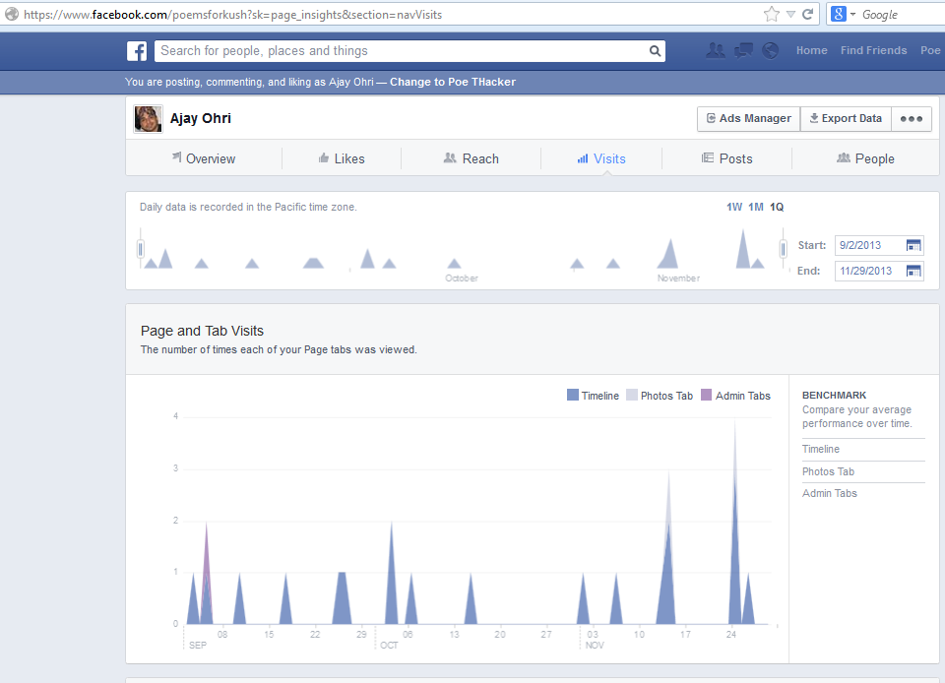
SOCIAL MEDIA
Facebook Business Page, Twitter and Instagram – Business to Customer communication (B2C)
Engagement Example:
YOUR GOALS – Brand Awareness, Website Traffic, Hijacking trends
+
YOUR AUDIENCE – Core, Custom (actual customers, email list, FB and website visitors, Lookalike)
+
TEXT
+
VISUALS
=
ENGAGING CONENT
Use the FB PAGE INSIGHTS tool
Your Social Media presence is paramount; it should be your secondary objective after your website.
The power of the Social Media platforms is the best and relatively free if you’re on a small budget.
The visual aspect is KEY to driving your target customers to your website and making sure that you stand out from the competition.

Slide 10
SOCIAL MEDIA - Continued
LinkedIn – Business to Business interaction (B2B)
Schedule a planner of how often to post, to which platform and be time specific
Consistency in posts – Quality and Relevance
Be on Brand Message – Luxury = Hi-Res quality images
Look at what the main industry leaders are doing for inspiration

Slide 11
QUESTIONS

